Slide 2
Gold Weekly Workshop Series Azure Functions
Aditya Raman
Gold Microsoft Learn Student Ambassadors

Slide 3


Aditya Raman
Gold Microsoft Learn Student Ambassador

Slide 4
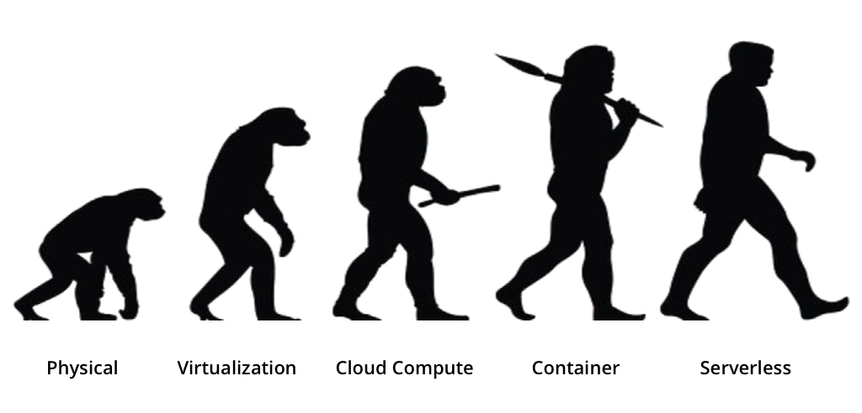

Slide 5
Physical
Physical Hardware
Expensive

Slide 6
Virtualization (VMs)
on top of host machine or the hardware host
own unique guest operating system
RAMs and Storage issues

Slide 7
Cloud Computing
Servers rented remotely
Over-purchase
Auto Scaling but, Distributed Denial-of-service (DDoS) attack

Slide 8
Containers
'contains' both an application and all the elements the application
No matter where it is hosted
Easily be moved around and deployed wherever needed
Less Compute Powers than VMs

Slide 9
Serverless Compute
Function as a Service
Stateless Compute Containers
Event-triggered and Ephemeral
Dynamically Allocated
Pay as you Go

Slide 10
Advantages
Lower Operational Cost
Easily Scalable
Billing is based upon Usage
Easy Deployment
Low Cost

Slide 11
Disadvantages
Complex Architecture
Execution Time
Execution Frequency

Slide 12
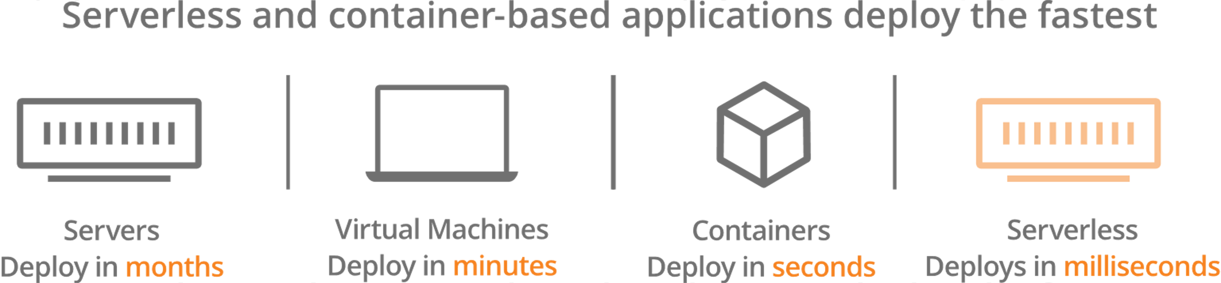

Slide 13
Invoking Serverless
Cold Start
Warm Start

Slide 14
When (and why) not to go serverless

Slide 15
Latency
Cold start times increase linearly with memory and code size
Python & Go have lower cold start times, whereas C# & Java have the highest cold start times.
Cold start times increase due to extra overhead of provisioning networking resources

Slide 16
Heavier reliance on vendor ecosystems
Lose control over server hardware
Runtimes and runtime updates
Limited Resources attached with providers

Slide 17
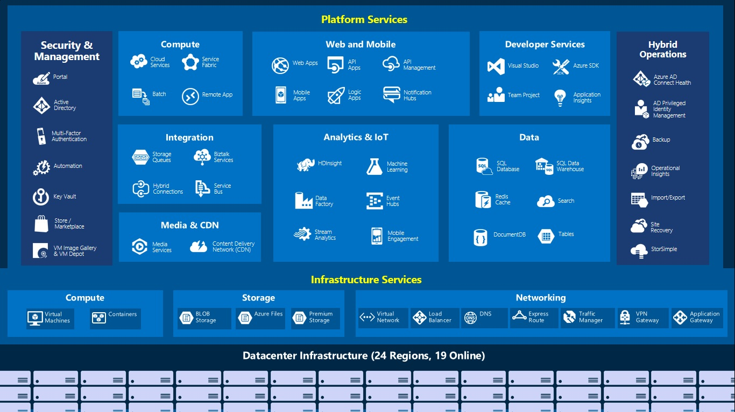
Azure

Slide 18
Azure Functions
Azure Functions is a serverless compute service that lets you run event-triggered code without having to explicitly provision or manage infrastructure.

Slide 19
Azure Functions Core Tools
To develop and test the functions locally using a terminal or command prompt. This is required and can be downloaded from here.
http://bit.ly/azure-functions-core-tools

Slide 20
Creating Functions Project
The command initializes the project and creates a project directory — worker-runtime denotes the language you want to use in the application
$ # This will generate a folder containing two files host.json
and local.settings.json
$ func init hello --python

Slide 21
Creating Functions Template
Add a function to your project by using the following command, where the --name argument is the unique name of your function (HttpExample) and the --template argument specifies the function's trigger (HTTP).

Slide 22
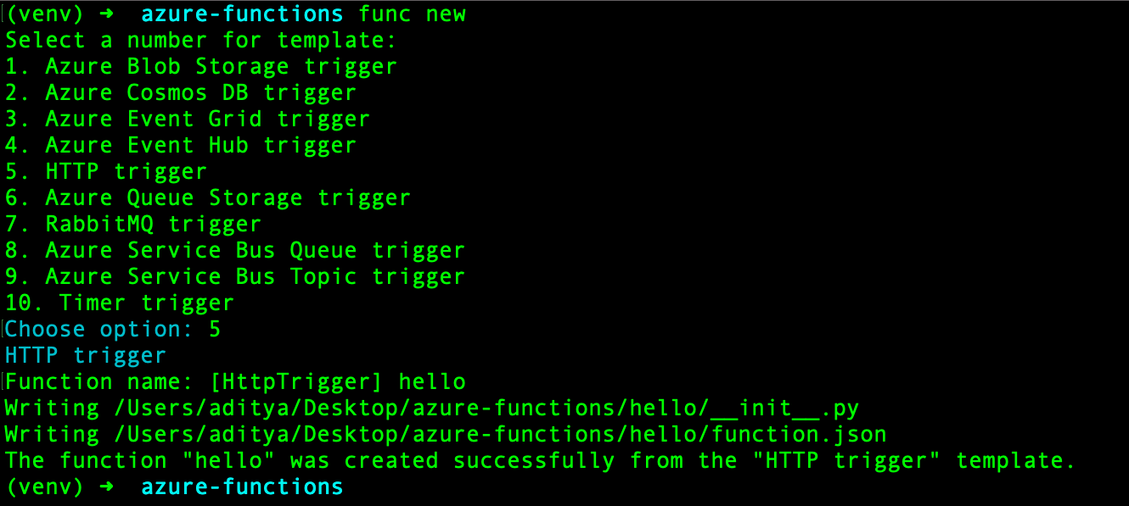
Creating Functions Template

Slide 23
QnA

Slide 24

Resources

Slide 25
Thank You

